Slide 1
MDM Security:
LDAP

Slide 2
AGENDA
LDAP (Lightweight Directory Access Protocol)
LDAP Integration With MDM

Slide 3
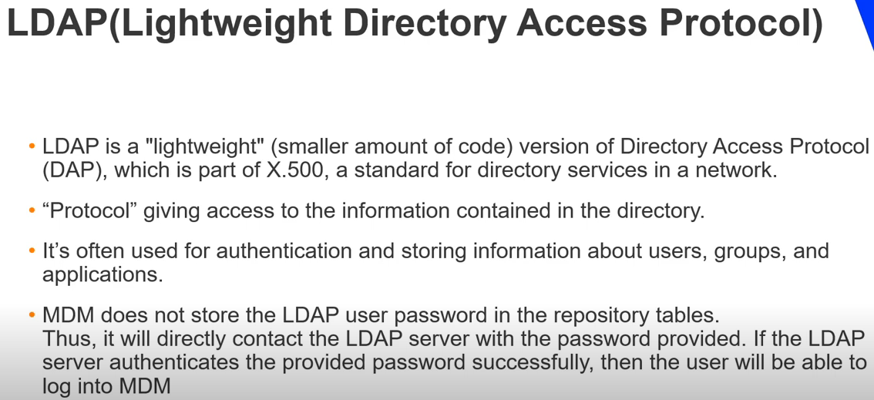
Background
LDAP:

Slide 4
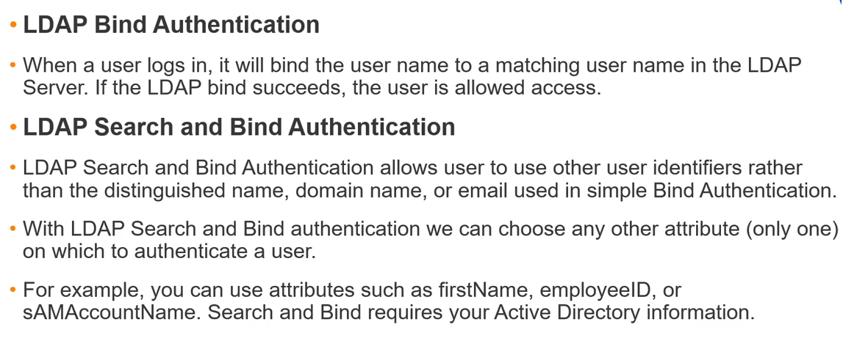
Two Type LDAP
Bind Authentication
Search & Bind Authentication
LDAP:

Slide 5
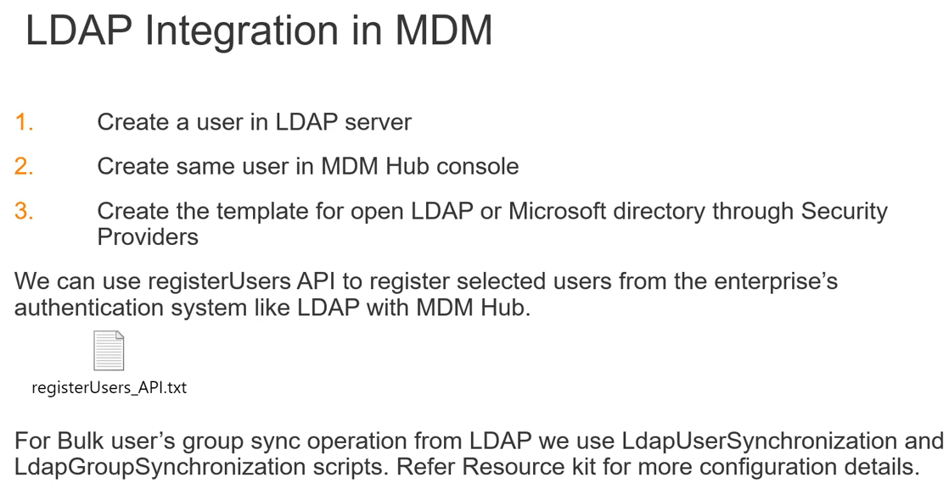
Automation.properties
LDAP:

Slide 6
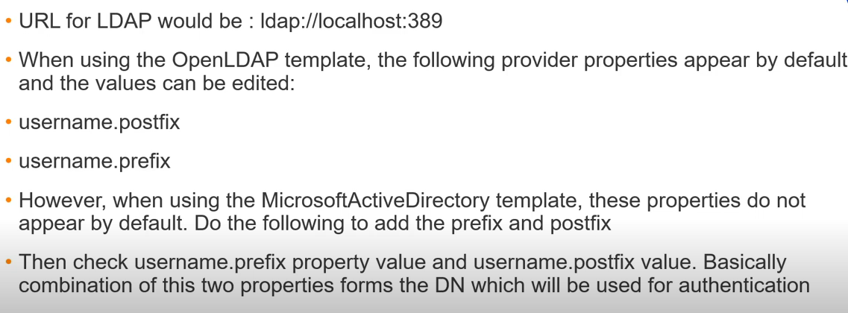
Create user in LDAP server should be done by LDAP team
LDAP:

Slide 7
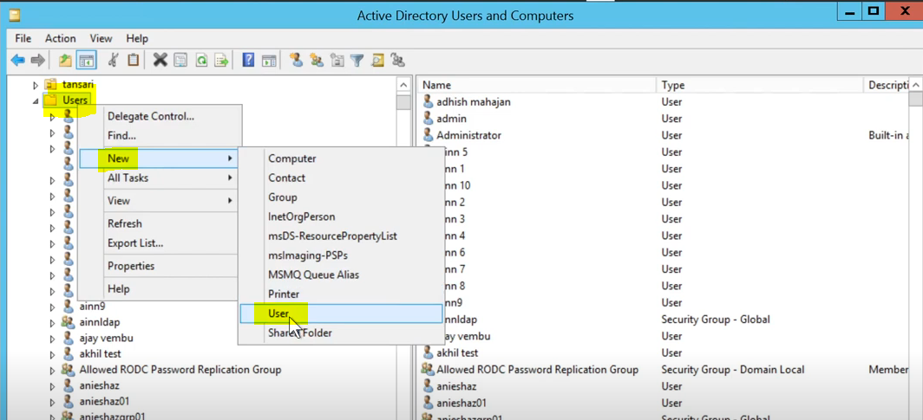
Add User in LDAP
LDAP:

Slide 8
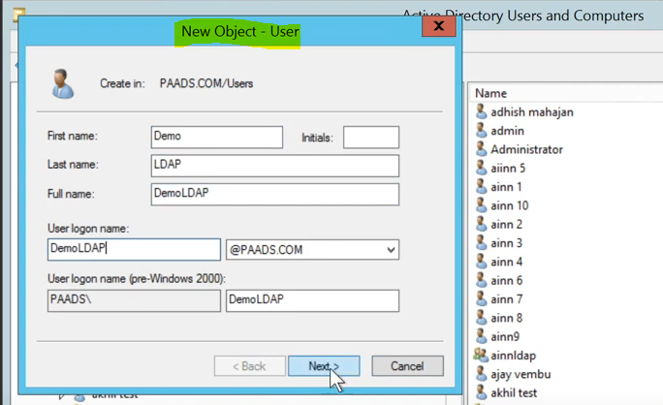
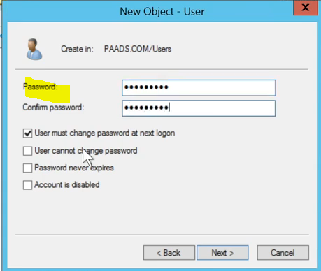
To Delete User
LDAP:

Slide 9
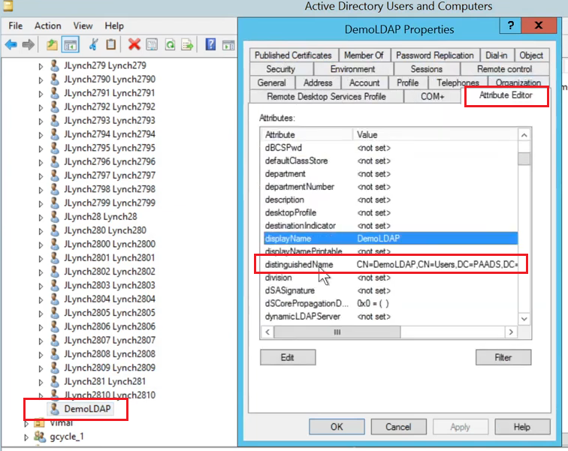
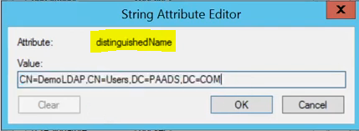

Assign Role To User
LDAP:
Prefix
LDAP User Name
PostFix

Slide 10
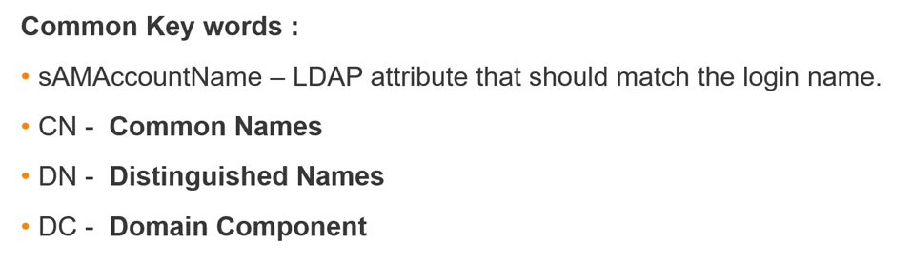
Assign Role To User
LDAP:

Slide 11
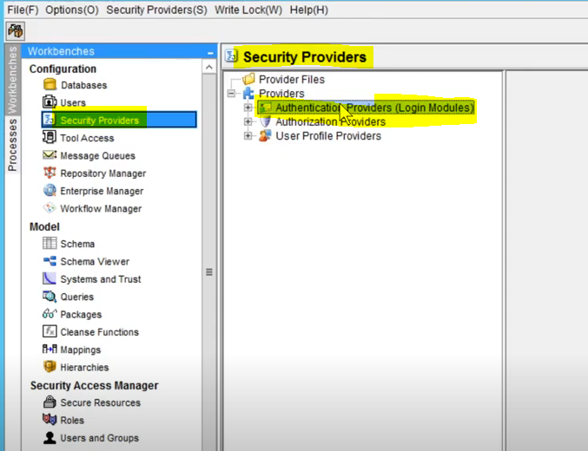
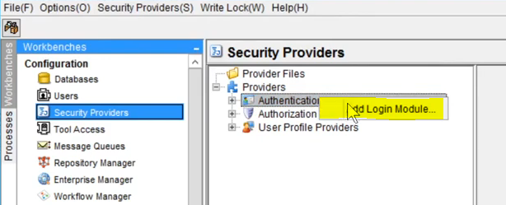
Script Path
LDAP:

Slide 12
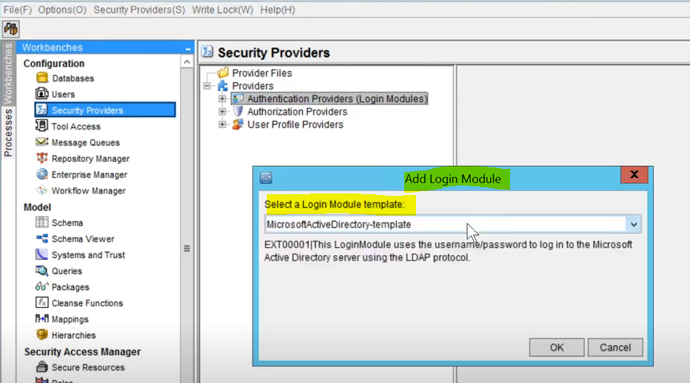
Automation.properties
LDAP:

Slide 13
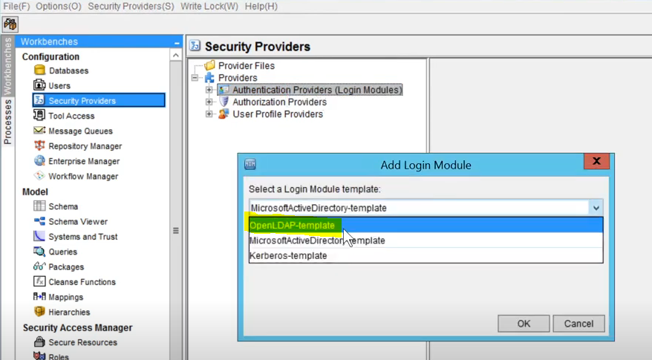
Script
LDAP:

Slide 14
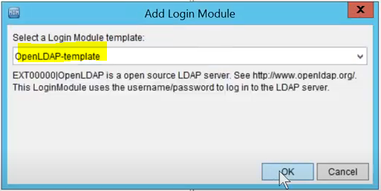
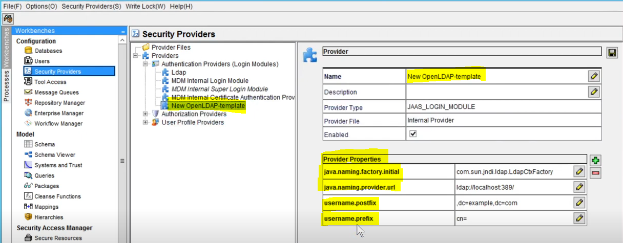
Script
LDAP:

Slide 15
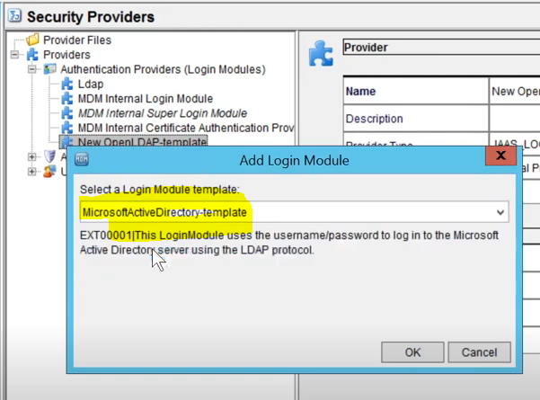
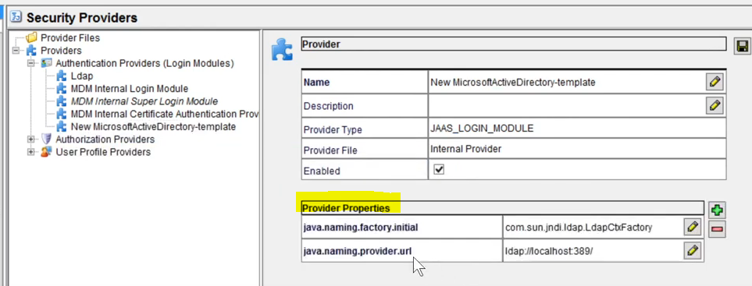
If you add Microsoft ActiveDirectory-template
Then manually add postfix and prefix
LDAP:

Slide 16
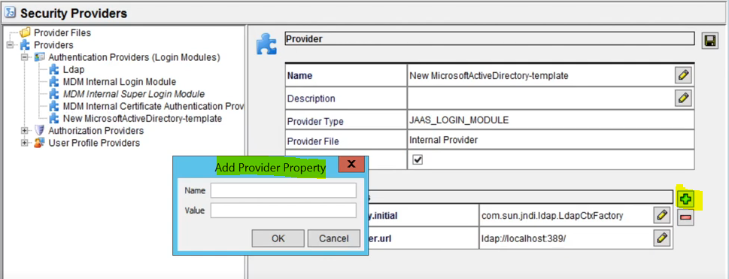
Add Provider Property
MDM
Automation:

Slide 17
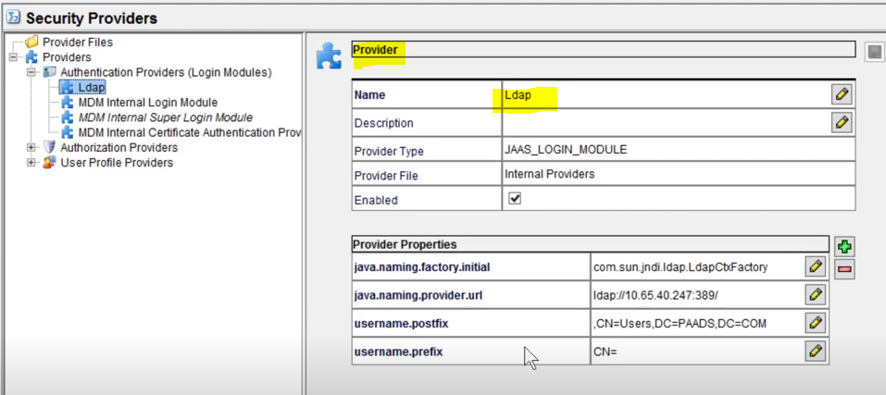
Assign Role to User
LDAP:

Slide 18
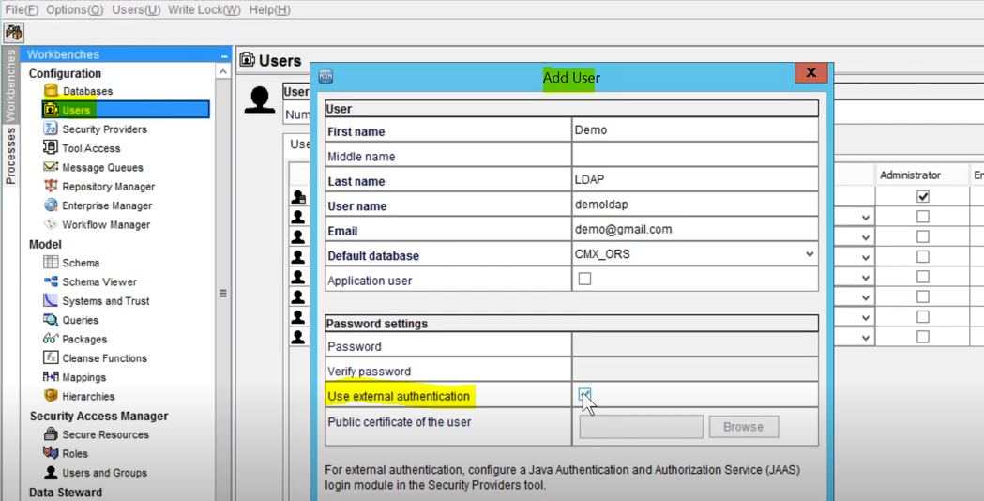
Assign Role To User
LDAP:

Slide 19
Assign Role To User
LDAP:

